Slide 1
Leadership camp
9th April ’08 – 11th April ’08

Slide 2
Personality Development 1
Articulation Skills:
Ability to articulate points of view
Written Communication Skills:
Proficiency in E-mailing skills and documentation
Cross Cultural Sensitivity:
To work efficiently in multi-cultural environment
Assertiveness Skills:
Articulation Points of View Firmly and convincingly

Slide 3

Personality Development 2
Self Concept
The ability to build confidence in oneself by creating self-awareness
Interpersonal Effectiveness
Help interact with people from diverse backgrounds
Business Communication
Proficiency in language and business communication

Slide 4
Soft Skill program
English Language Program
Fundamentals of Communication
Active Listening Skills
The nuances of communication using specific skills such as body language, clarifying, paraphrasing and summarizing.
Time Management:
To help an individual plan and prioritize his or her activities and manage time effectively
What is Competency?
Knowledge Skills and Attitude

Slide 5
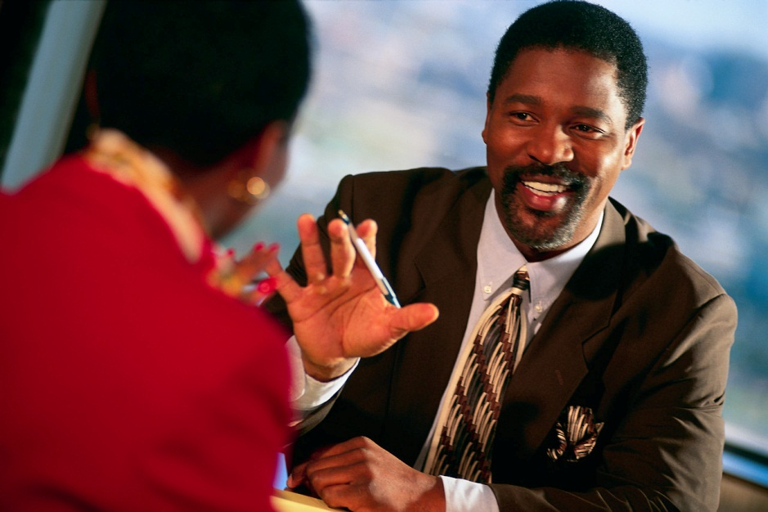
In the competitive environments that pervade today's work place, the only differentiator is one's performance. The enablers of performance are an employee's 'competencies' - knowledge, skills and attitudes that are observable, measurable, comparable with benchmarks and trainable.

Slide 6
THANK YOU

